Slide 1
Real Estate Valuation
Data Science Project

Slide 2
Real estate valuation is the process of determining the value of real estate property.
Some factors affecting the value of houses are location, home size and useable space, age and condition of the house, and availability of social amenities.
By examining real estate valuation, we understand the reasons for people's choice when purchasing a real estate property

Slide 3
Details on the dataset
Title: Real estate valuation data set
The dataset used is of market historical dataset of real estate valuation collected from Sindian District, New Taipei City, Taiwan.
The price per unit is based on a unit measure of 3.3 metres squared. There are 414 instances with 7 attributes.

Slide 4
Sources
Original Owner and Donor:
Name: Prof. I-Cheng Yeh
Institutions: Department of Civil Engineering, Tamkang University, Taiwan.
UCI Irvine Machine Learning Repository
https://archive.ics.uci.edu/ml/datasets/Real+estate+valuation+data+set

Slide 5
Description of columns
House no: House number
Transaction date: Date when the purchase was done
House age(years): The age of the house in years
MRT station(metres): Distance from MRT station in metres
Convenience stores: Number of convenience stores around
Latitude: Geographical coordinate
Longitude: Geographical coordinate
Unit price: House price of unit area(3.3 metres squared)

Slide 6
Problem Statement.
To develop a model that can be used to predict real estate value.

Slide 7
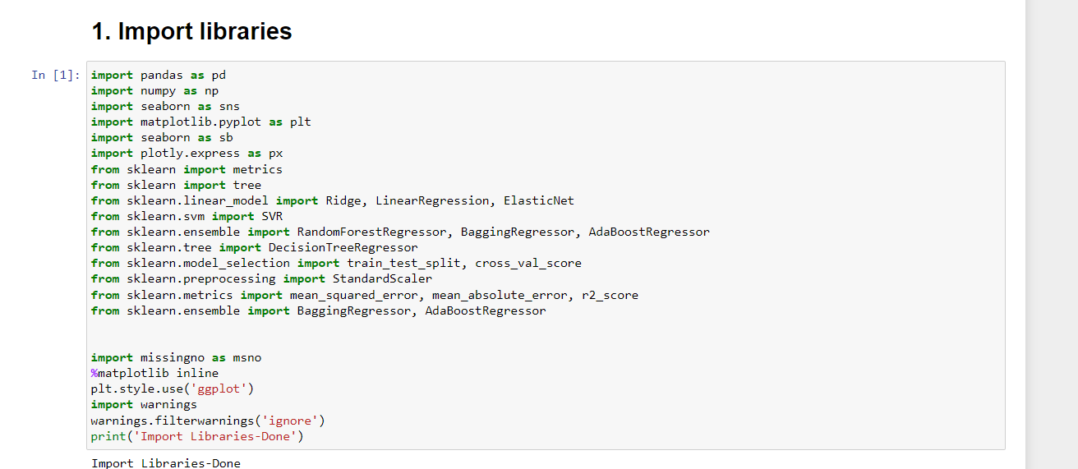

Slide 8
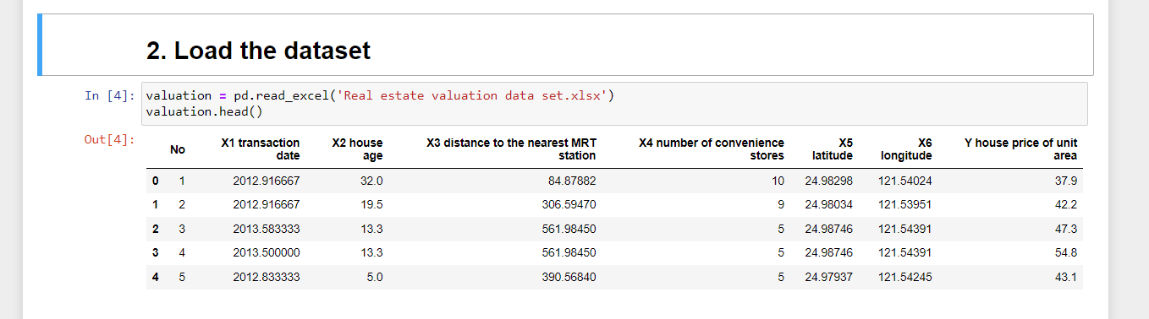

Slide 9
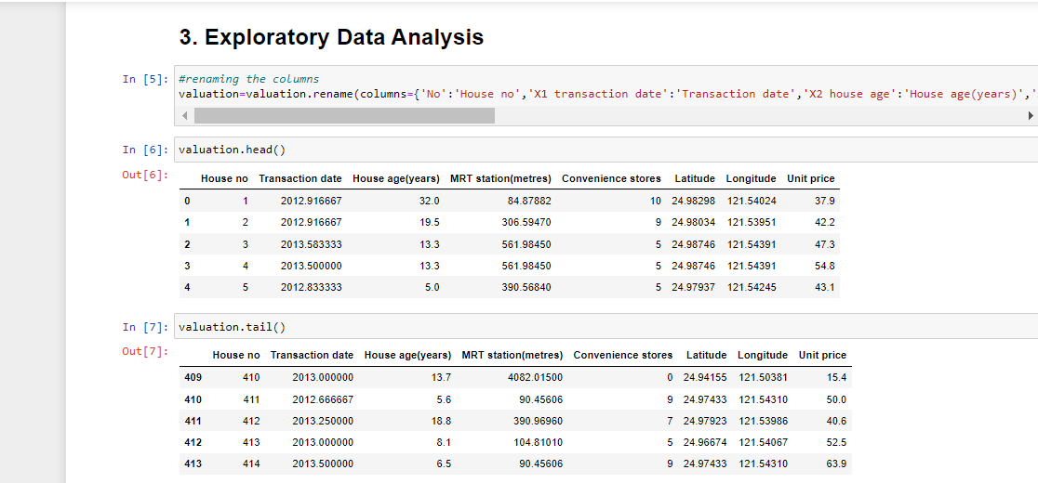

Slide 10
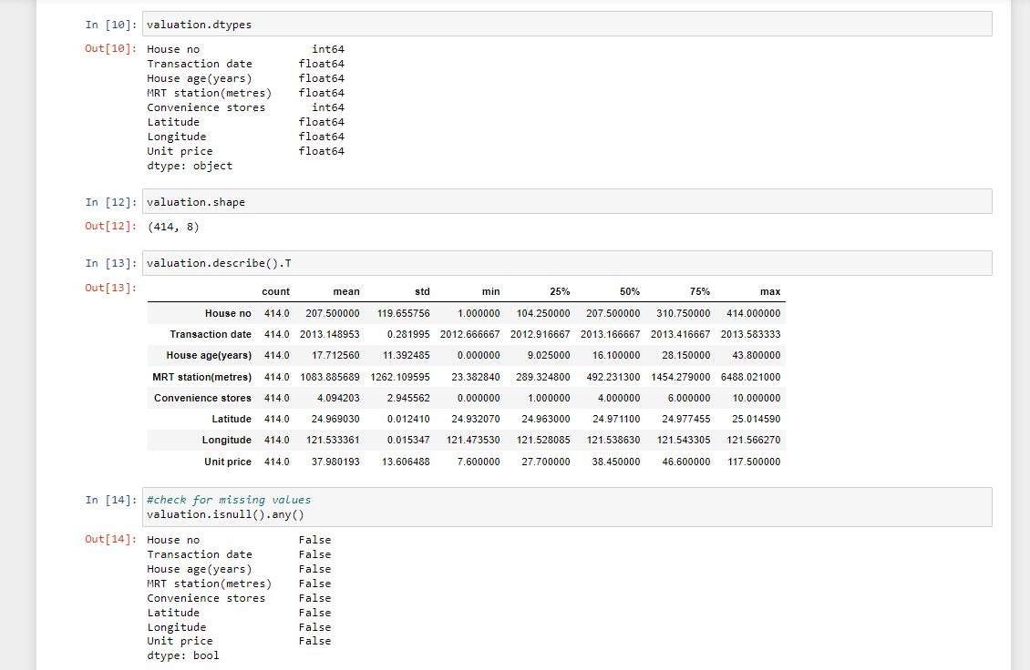

Slide 11
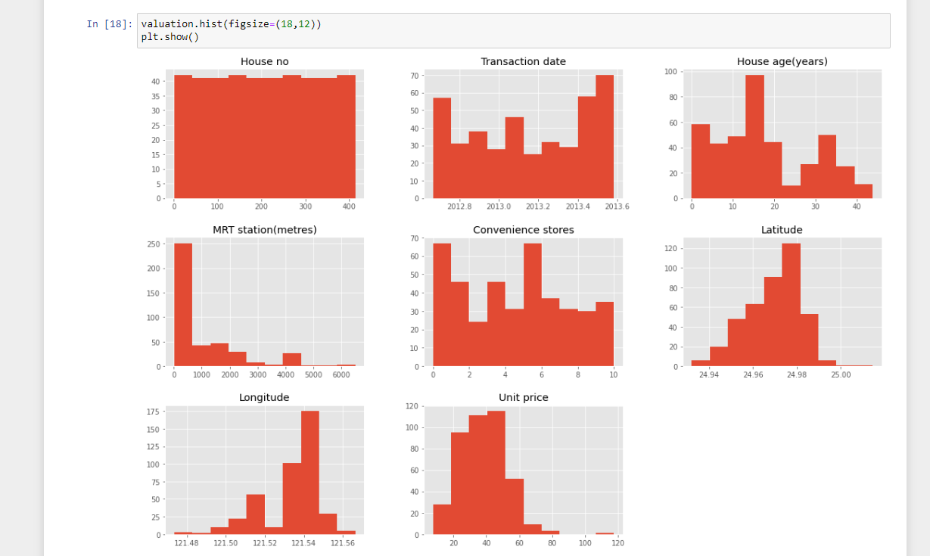

Slide 12
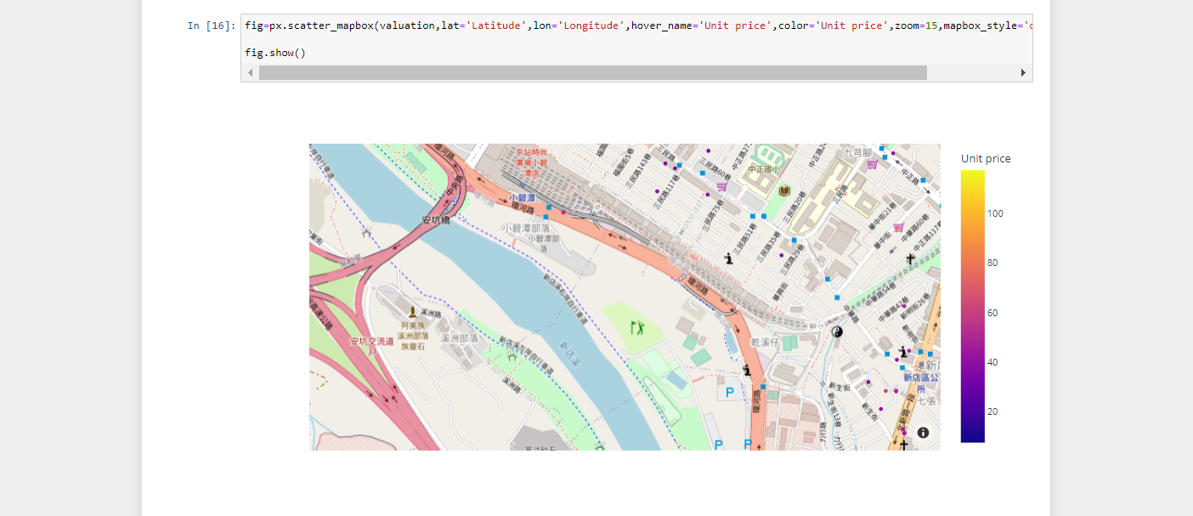

Slide 13
Observation
The house ages range from 0 to over 40 years. Majority of the houses range from 10 years to 20 years.
Most houses are within 1000 metres(1 kilometre) to the MRT station.
The houses in this region are not evenly distributed with most distribution on the eastern side of the town.
The western side of the town has houses of lower price per unit area as compared to the eastern side.

Slide 14
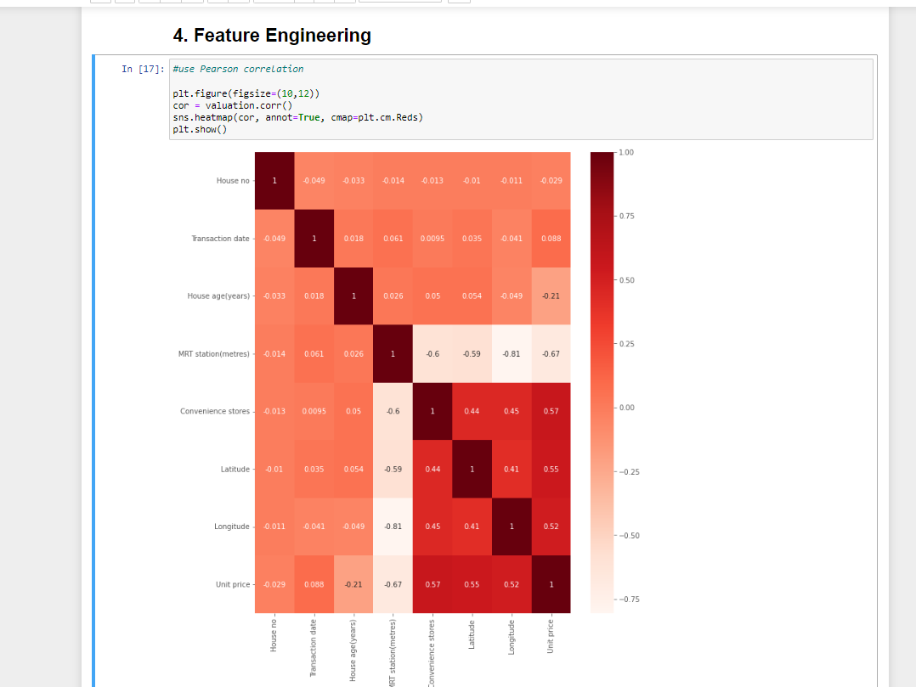

Slide 15
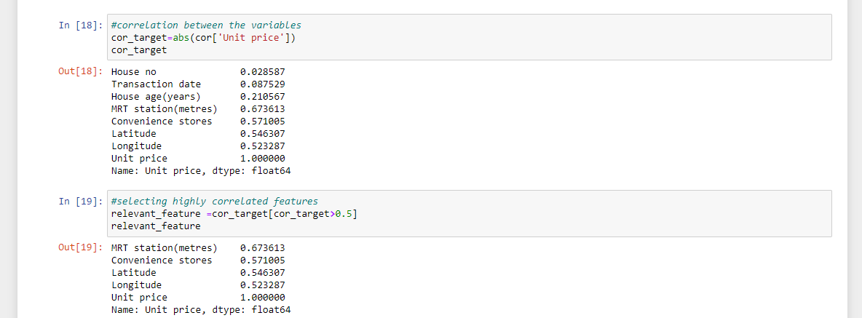

Slide 16
The variables that are highly correlated to our target column (Unit price) are:
MRT station(metres)
Convenience stores
Latitude
Longitude
These variables will have an effect on the prediction of Real Estate Valuation

Slide 17
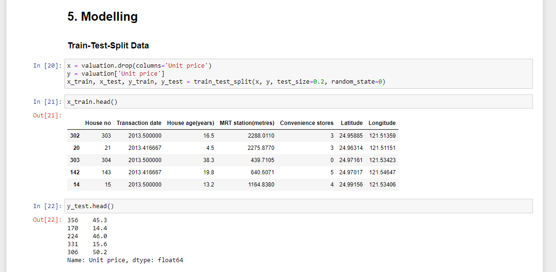

Slide 18
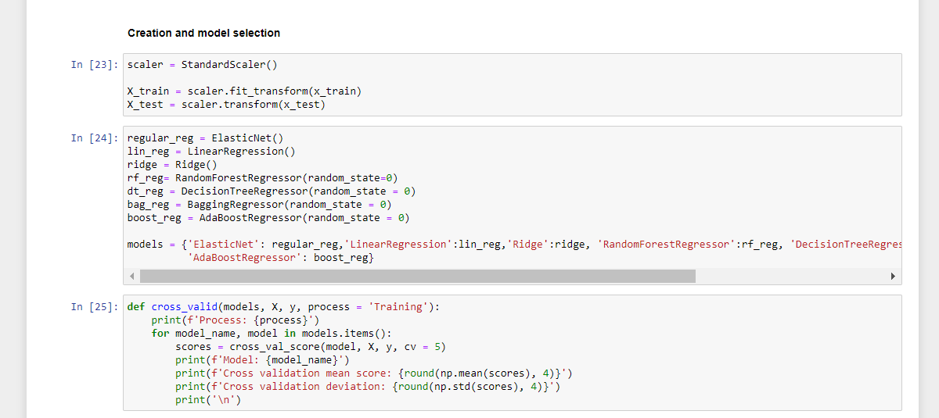

Slide 19
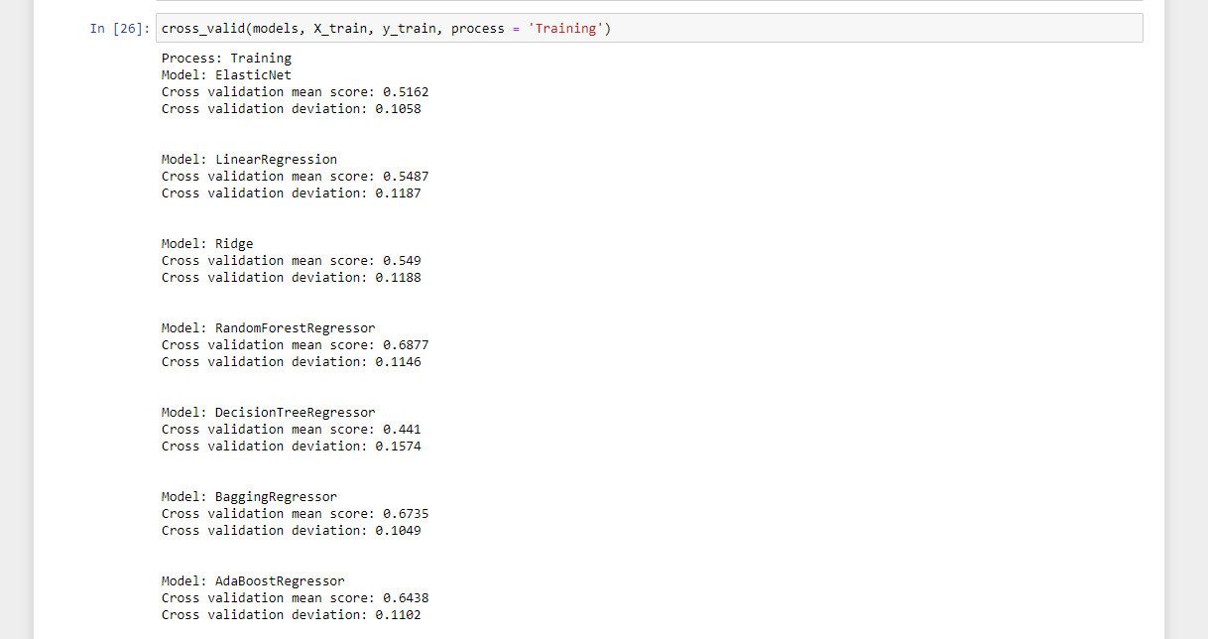

Slide 20
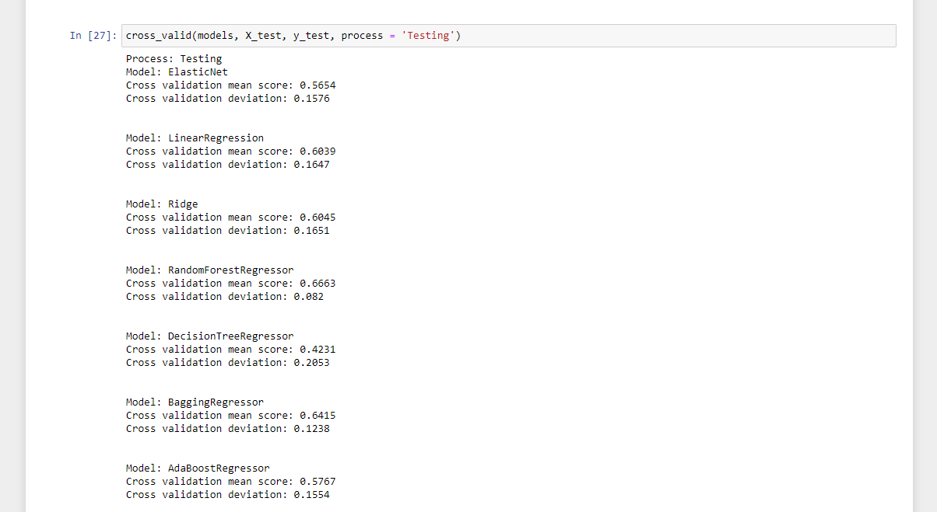

Slide 21
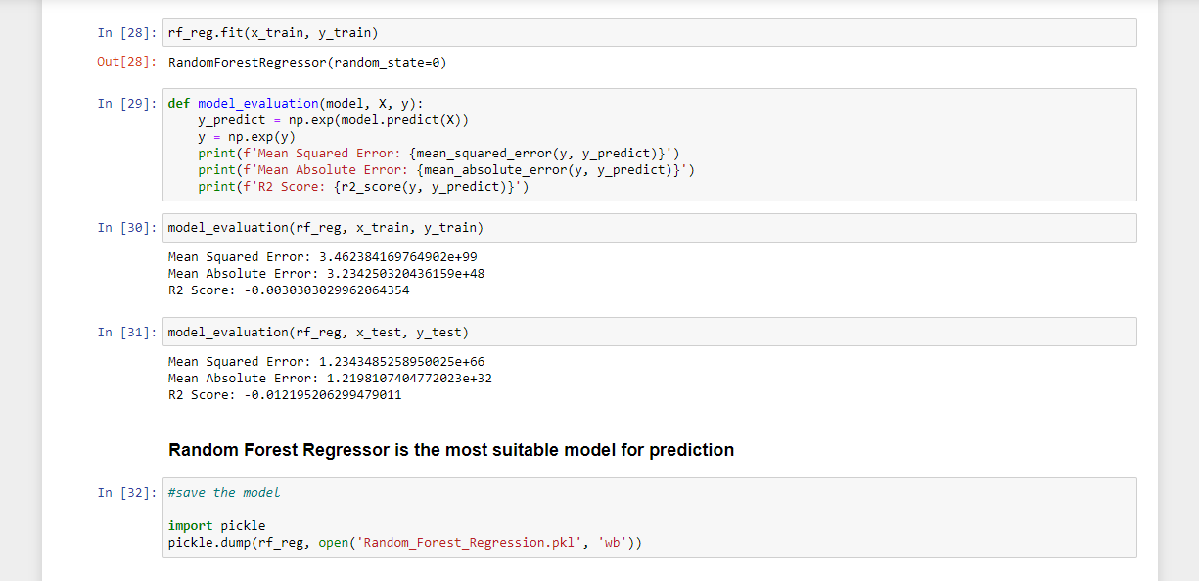

Slide 22
Conclusion
The value of a house is affected by Latitude and Longitude(location), how far it is from the MRT station and the number of convenience stores around.
House age(years) and Transaction date have an effect but are not significant.

